Slide 1
Final Project 3: Why Employees Leave
Raymond Delacruz

Slide 2
Topic/Problem
This project analyzes a simulated data set on why experienced employees leave. My goal is to try and predict if an employee will leave and to understand which features have the highest impact.
For every employer, they want to ensure that they retain their employees for various reasons. Replacing a current employee would not only take time and resources, but the employer loses the institutional knowledge that has been placed in their employee for however long he/she worked for them. According to the Bureau of Labor Statistics, 5.2 million people separate from their jobs every month. Using different machine learning methods, I will try to answer the question: Why do employees leave?

Slide 3
Data Set
Kaggle – Human Resources Analytics
Features include:
1) Satisfaction Level: Level of happiness at work. (1 = highest, 0 = lowest)
2) Last Evaluation: Time that has past since the employee's last evaluation.
3) Number of Projects: The number of projects an employee worked in during their tenure.
4) Average Monthly Hours: On average, the number of hours an employee works a month.
5) Time Spend with the Company: The number of years the employee was with their employer.
6) Work Accident: Shows if the employee had a work related accident. (1 = yes, 0 = no)
7) Left: Whether the employee left the company. (1 = yes, 0 = no)
8) Promotion within the last 5 years: Whether or not an employee was promoted within the past five years.
9) Department: The division the employee works in.
10) Salary: Categorical level of how much an employee is paid. (low, medium, high)

Slide 4
Process
EDA
KNN
Model
Decision Tree
KNN (Cont.)

Slide 5
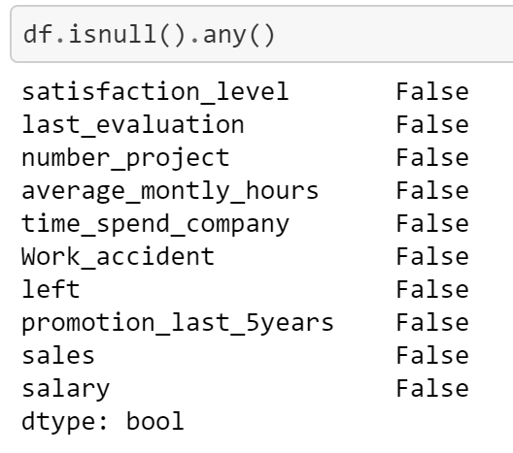
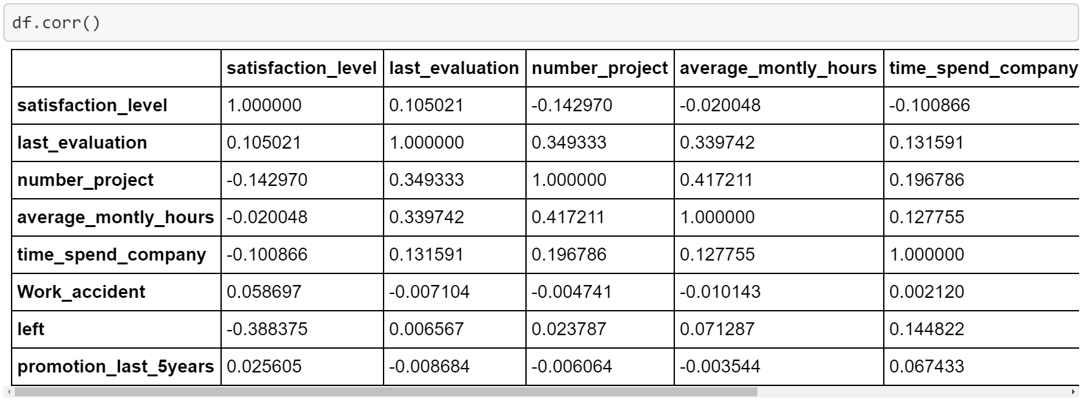
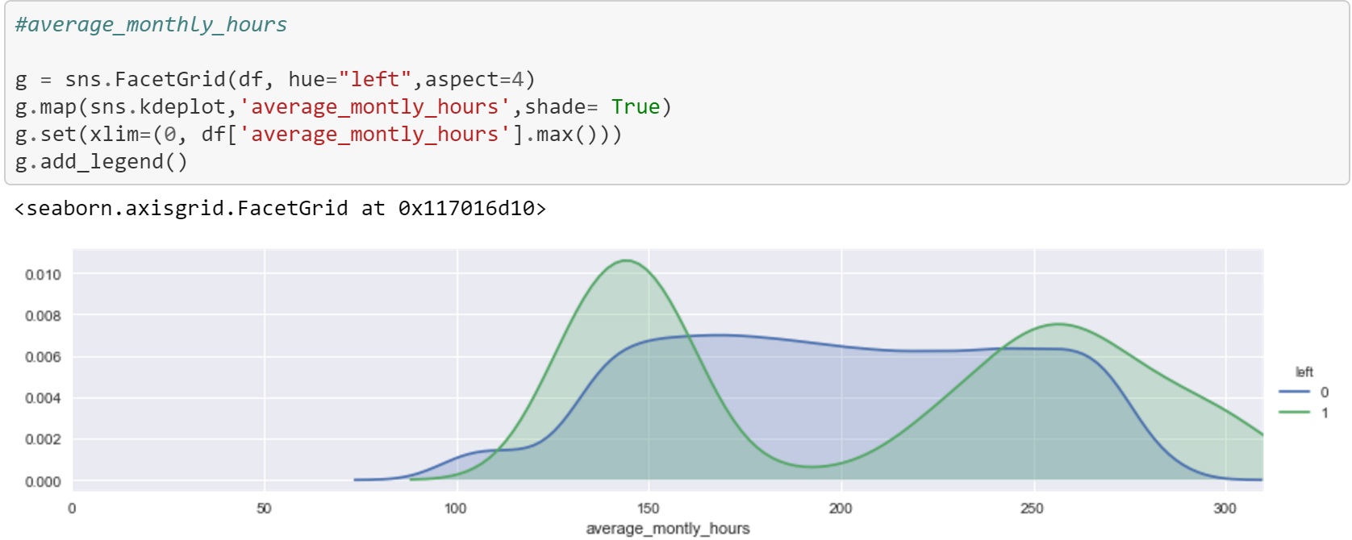
Exploratory Data Analysis
Is Null
Correlation
Average Monthly Hours
The data set is clean
No null values
A distribution of how correlated each data point is with each other
Helps determine which features to select
A visualization of average monthly hours compared to who left and stayed

Slide 6
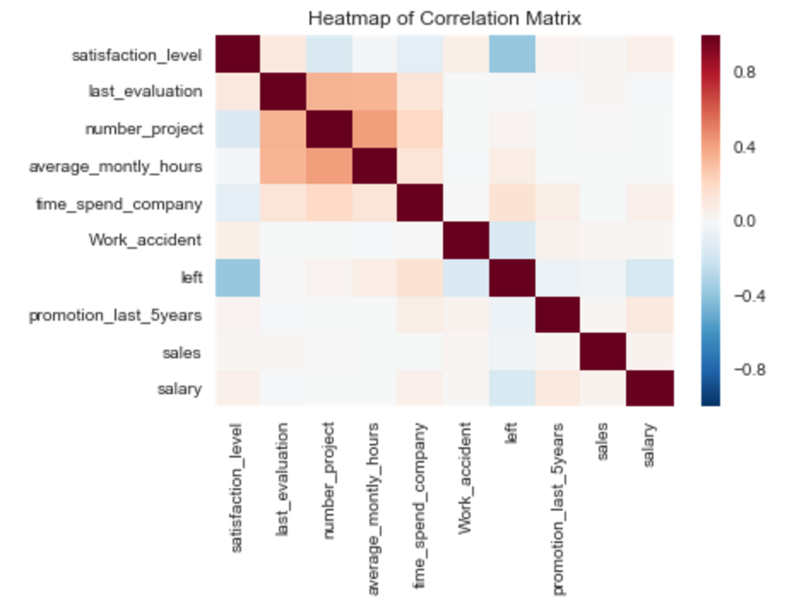
Heatmap
Colorful heatmap
Correlations between features used in the model
Satisfaction level, number of projects, and average monthly hours worked have strong correlations with the employees who left

Slide 7
Hypothesis and Method
Hypothesis
Based on HR data, a machine can predict whether or not an employee will leave better than the null accuracy. However, there will be outliers that fall into the false positives and false negatives of the model.
Method
Producing a machine learning model that will take in features related to the employee and predict whether or not the current employees and new employees introduced to the model will leave or stay

Slide 8
Machine learning models
Initial Features Selected: Satisfaction level, number of projects, and average monthly hours worked
Target (response): Binary classification for employees who left (1) or stayed (0)
Null Accuracy (score to beat): 0.68752187609
Train: on current HR Analytics data set
Predict: on current HR analytics data set

Slide 9
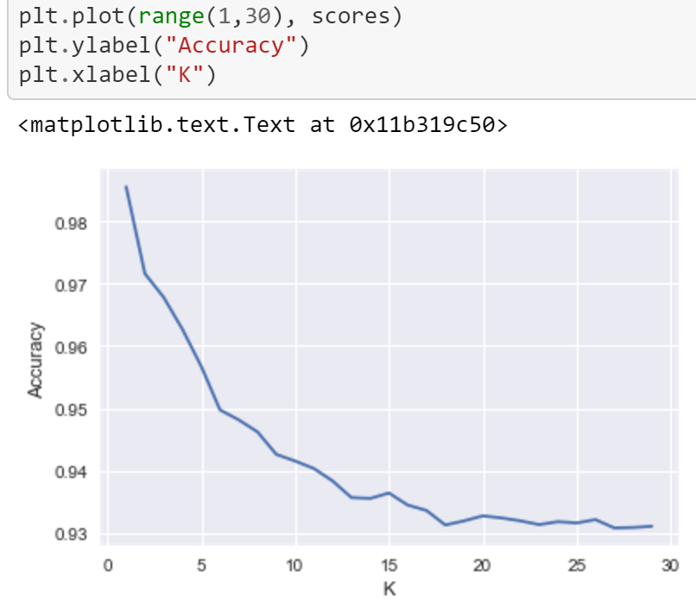
K-Nearest Neighbor
Initial model was fitted with 1 neighbor, but it was not accurate
Accuracy decreases as more neighbors are added.
Focused on using the point at the elbow to enable a balance of overfit and accuracy to provide a broader generalization of the data

Slide 10
KNN – Test | Train | Split
Accuracy score when fitted from original dataset using 9 neighbors: 0.9425961730782052
Accuracy score when training and testing with 80% of the data frame: 0.931733333333
Cross Validation accuracy score: 0.94119768588122432
Score is above the null accuracy score

Slide 11
Test | Train | Split (w/ Salary)
Accuracy score when fitted from original dataset using 9 neighbors: 0.93939595973064871
Accuracy score when training and testing with 80% of the data frame: 0.9285333333333
Cross Validation accuracy score: 0.94079730808118234
Score is above the null accuracy score, but all of these scores are lower than initial model without salary

Slide 12
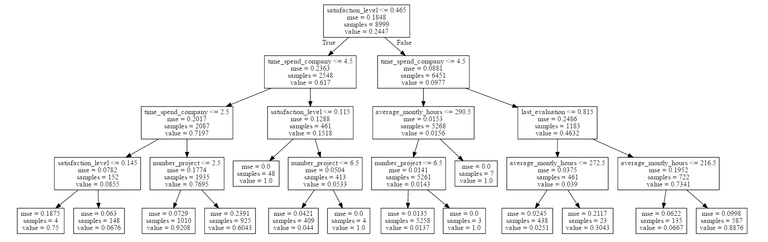
Decision Tree

Slide 13
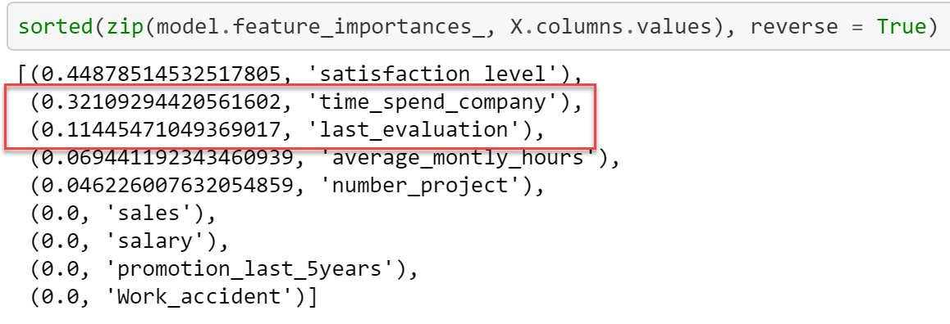
tree - feature selection
Initial model includes:
Satisfaction level, average monthly hours, and number of projects
After creating a decision tree, see higher levels of correlation with different features

Slide 14
Test | Train | Split (New Model)
Accuracy score when fitted from original dataset using 9 neighbors: 0.96833122208147204
Accuracy score when training and testing with 80% of the data frame: 0.9632
Cross Validation accuracy score: 0.96686468713311347
Score is above the null accuracy score and 2 other models with 2 new features

Slide 15
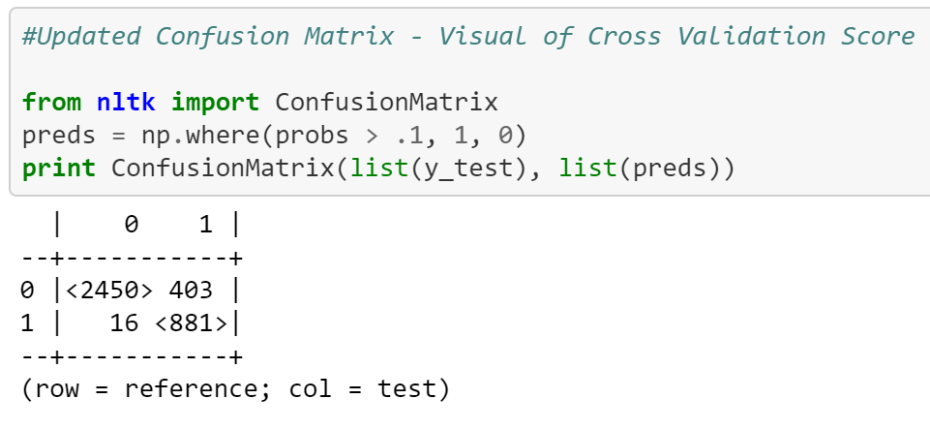
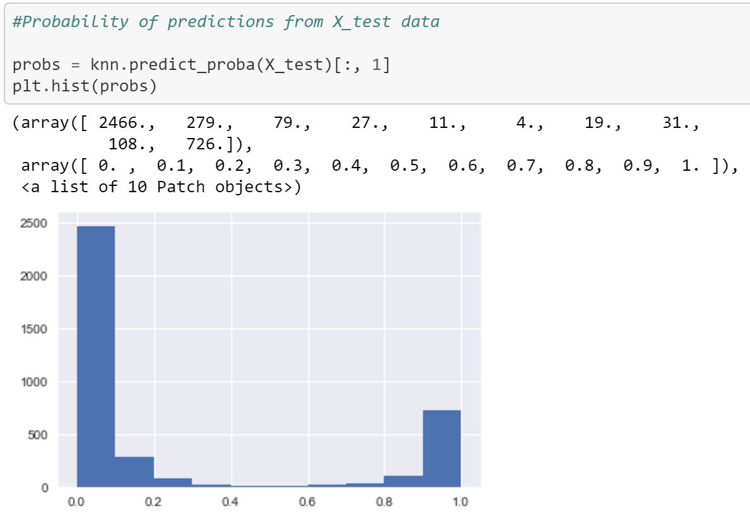
Confusion matrix and tuning

Slide 16
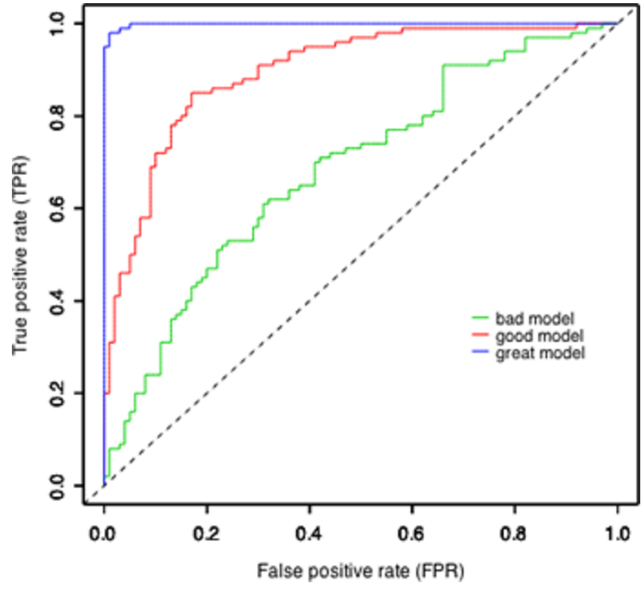
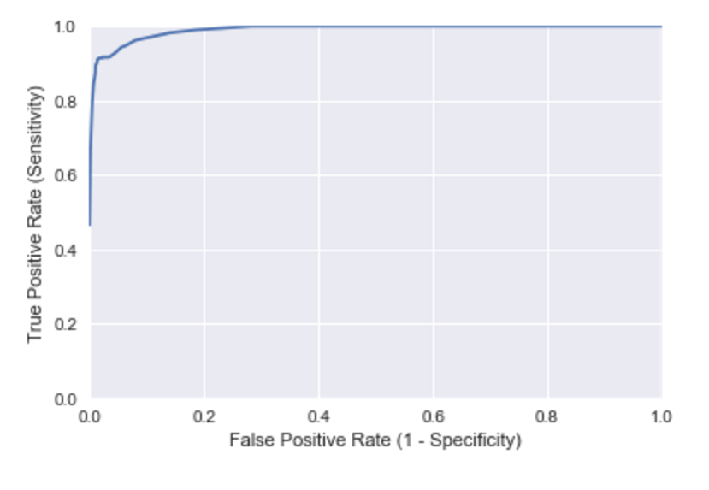
ROC Curve – model evaluation
Class
Project

Slide 17
Conclusion
Satisfaction level is the most correlated feature in the data set
3 features made up ~ 88% of the most “important” features to split on for the decision tree (satisfaction level, time spent with company, last evaluation)
Data was not complete, salary was an example where creating categories based on arbitrary categories can skew some of the prediction results

Slide 18
Next Steps
Understanding and determining different combinations of features and their relationship with each other
Work on tuning the confusion matrix to train the model to get closer results I am specifically looking for
Use a gini index to evaluate and optimize the decision tree

Slide 19
aPPENDIX

Slide 20
References
Kaggle Data Set
Bureau of Labor Statistics

Slide 21
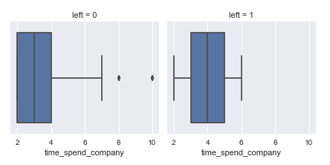
Time Spent with Employer

Slide 22
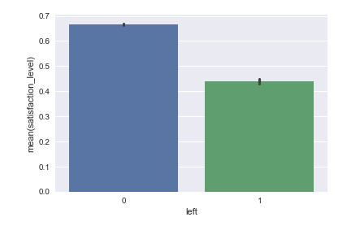
Satisfaction level

Slide 23
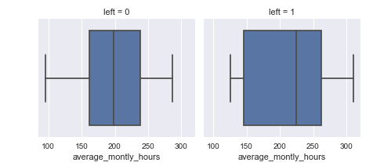
Average Monthly Hours

